Slide 1

PROJECT PRESENTATION DS105
Machine Learning Models - STI component stocks
Stella Tan

Slide 2


PROBLEM STATEMENT
While the overarching principle in stock market trading is to “buy low, sell high”, investors need to be aware of more information on how stock markets behave and a more systematic framework of guiding their investment decision.
Investors are split into two factions; those who believe the market cannot be predicted and those who believe the market can be beaten.
In today’s world, much information pertaining to stock market is available digitally. Analyzing all this information individually or manually is tremendously difficult and time consuming. As such, automation of the process is required and we look to data mining processes, machine learning and data prediction for help, to see if we can predict stock prices and hence trade off these signals.

Slide 3

To explore if it is possible to predict stock (local) prices using technical indicators and historical price data of the stocks
To have an idea of which models perform better in predictions and methods to improve performance

Slide 4

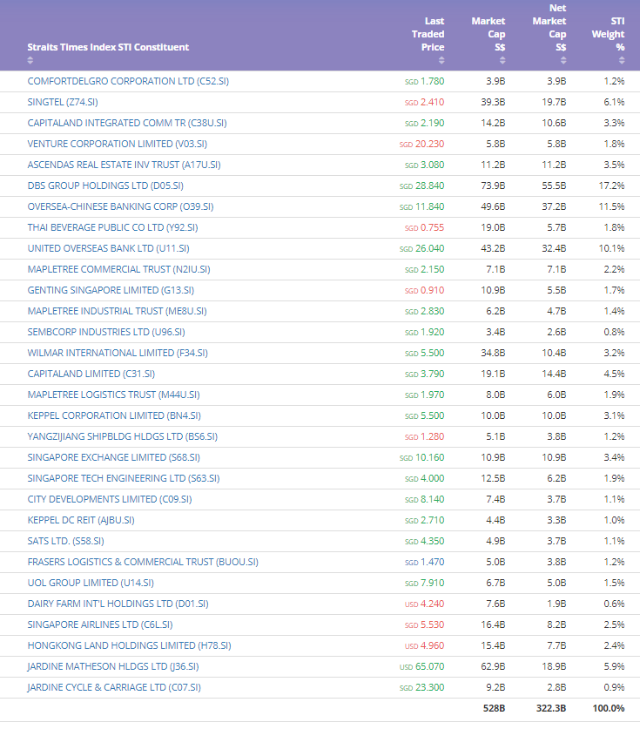
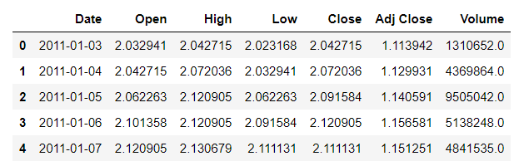
DaTA SET
10 years of daily data of the 30 stocks (in the STI) from YahooFinance, downloadable in CSV format. Includes open, high, low, close prices and volume.
Some null values were removed
80% used for training and 20% used for testing
Technical indicators from talib

Slide 5

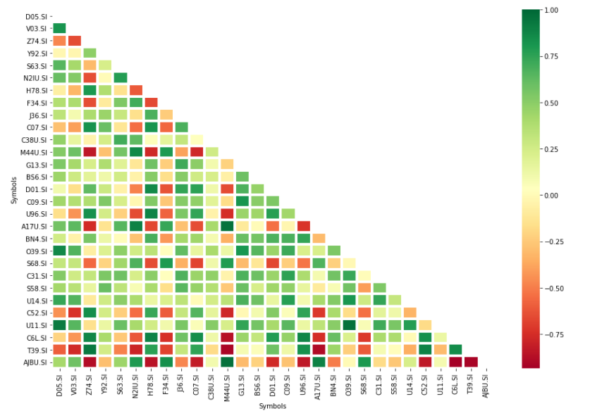
VISUALISING THE DATA
We notice that some interesting positive correlations exist especially among stocks in the same sectors for example between
DBS and OCBC or UOB.
Some correlations do not make direct intuitive sense, for example Dairy Farm in the consumer sector is strongly negatively correlated with Keppel DC Reit which has data centres in its portfolios
Thus I think its is quite challenging to use correlations as one of our features in this study and will put it aside first, to consider later.
Financials - UOB, SGX, OCBC, DBS
Industrials - ST Engineering, SIA, SATS, Comfort, Keppel, Sembcorp Industrial, Jardine JMH, Jardine JMS, YZJ
Real Estate - Capitaland, UOL, Ascendas Reit, City Development, HKLand, Capita Integrated Comm, Keppel DC Reit, Frasers, Mapletree Comm, Mapletree Log, Mapletree Ind
Consumer - Dairy Farm, Jardine , Genting, Wilmar
IT/Communications - Singtel, Venture

Slide 6

ALGORITHMS and MODELS
We will use supervised learning => regression model to predict stock prices. The stocks are appended in a list and we can call any one out to run this analysis as the stock is not hardcoded.
5 models/algorithms will be considered here – Linear Regression, Decision Tree, Random Forest, Support Vector and XG Boost
Metrics used include RMSE, MAE, R2 and adjusted R2. Residuals plots are also used.
Cross validation using K Folds Validation
Hyperparameter tuning where applicable
Checking predicted values versus true values

Slide 7
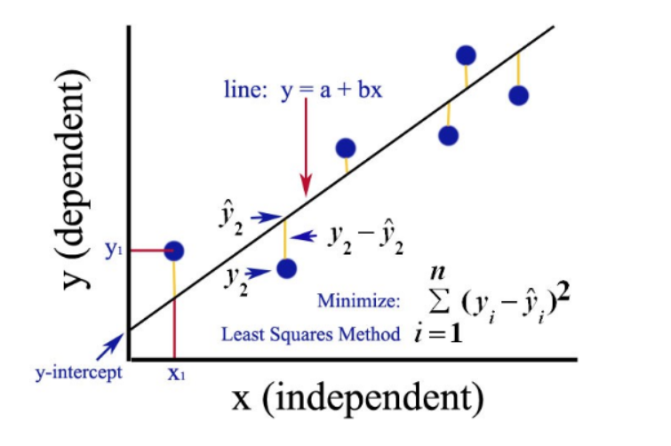
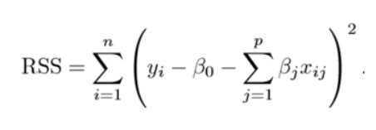
LINEAR REGRESSION
A statistical model that is used to determine the relationship between one dependent variable
Y and a series of other independent variable/variables (ie multivariate regression)
Objective: To obtain a line that best fits the data points where total prediction error (for all data points) are as small as possible.
The Ordinary Least Squares (OLS) method seeks to minimize the sum of the squared residuals.
A simple relation for linear regression is:
Y ≈ β0 + β1X1 + β2X2 + …+ βpXp
Here Y represents the independent variable and β represents the coefficient estimates for different variables or predictors(X).

Slide 8
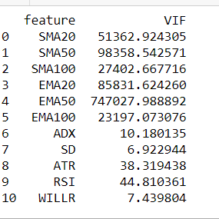
LIMITATIONS OF LINEAR REGRESSION
A) Multicollinearity - refers to the extent independent variables (predictors or features) in a regression model are correlated to each other.
Multicollinearity can result in several problems:
i. The partial regression coefficients may not be estimated precisely. The standard errors are likely to be high.
ii. It becomes unreliable when assessing the relative importance of the independent variables in explaining the variation in the dependent variable.
iii. Highly correlated variables will cause ‘double effect’ on the model which does not reflect reality.
When the number of independent variables is larger than the number of observations. When this happens, the OLS estimates are not valid mainly because there are infinite solutions to our estimators.

Slide 9
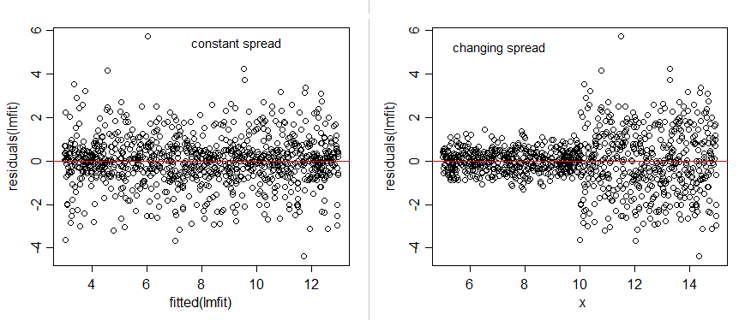
OVERFITTING AND REGULARISATION
Overfitting is a modeling error that occurs when a function or model is too closely fitting the training set.
Overfitting the model generally takes the form of making an overly complex model to explain model behavior in the data under study. The model will have a low accuracy if it is overfitting.
Regularization helps to address overfitting by shrinking the coefficient estimates towards zero. We use ridge regression, lasso regression and elas
HETEROSCEDASTICITY is where the variability of a variable is unequal across the range of values of a second variable that predicts it.
A scatterplot of these variables will often create a cone-like shape, as the scatter (or variability) of the dependent variable widens or narrows as the value of the independent variable increases.

Slide 10
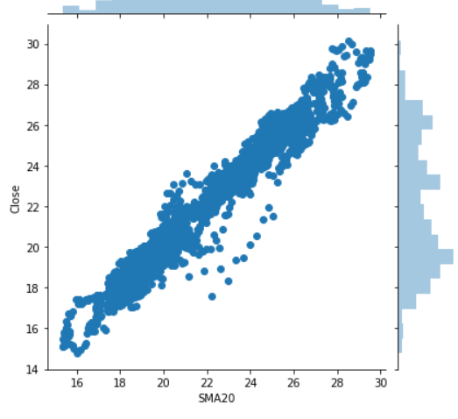
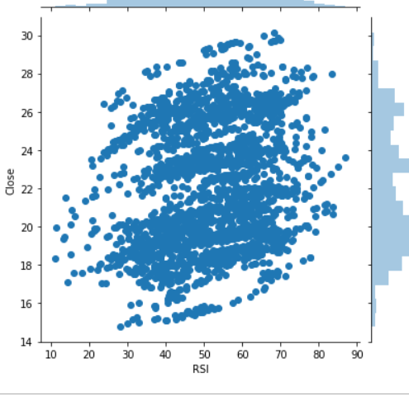
Features ENGINEERING
Percentage difference between Open and Close
Percentage difference between High and Low
Percentage difference of Volume
Simple Moving Average 20, 50, 100
Exponential Moving Average 20, 50, 100
Average Directional Movement Index
Standard deviation (rolling 20 periods)
Average True Range
Relative Strength Index
William%R

Slide 11
A simple moving average (SMA) calculates the average of a range of closing prices, by the number of periods in that range. It can be used to determine if an asset price will continue or if it will reverse a bull or bear trend.
An exponential moving average (EMA) is a type of moving average (MA) that places a greater weight and significance on the most recent data points.
Average Directional Movement Index (Momentum Indicator)
ADX can be used to help measure the overall strength of a trend and is an average of expanding price range values.
Standard Deviation (SD)
Standard deviation measures the dispersion of a dataset relative to its mean. It is calculated as the square root of variance by determining each data point's deviation relative to the mean. If the data points are further from the mean, there is a higher deviation within the data set.
Average True Range(ATR) (Volatility Indicator)
Average true range (ATR) is a volatility indicator that shows how much an asset moves, on average, during a given time frame. While the ATR doesn't tell us in which direction the trade will breakout, it can be added to the closing price, and the trader can buy whenever the next day's price trades above that value.
Relative Strength Index (RSI) (Momentum Indicator)
The relative strength index (RSI) is a momentum indicator used in technical analysis that measures the magnitude of recent price changes. The RSI is displayed as an oscillator, uses 14 periods in calculation and can have a reading from 0 to 100. It signals overbought or oversold price momentum.An asset is usually considered overbought when the RSI is above 70% and oversold when it is below 30%.
Williams%R (WILLR) (Momentum Indicator)
Williams %R, also known as the Williams Percent Range, is a type of momentum indicator that moves between 0 and -100 and measures overbought and oversold levels. The Williams %R may be used to find entry and exit points in the market.

Slide 12


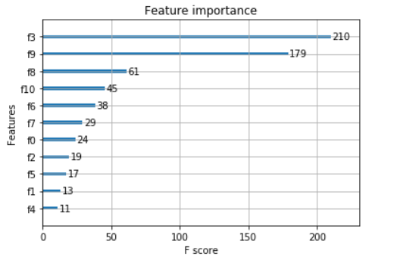
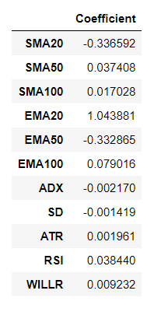
Lets test the model out on Comfort Delgro
Linear Regression Model
XG Boost Model
Features given more weight are the SMA20, EMA20 and EMA50, basically the moving averages.
Feature 3 SMA100 and Feature 9 ATR seems to be the top 2 important features using XGBoost

Slide 13
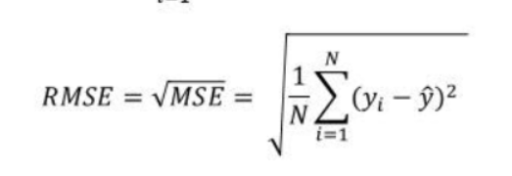
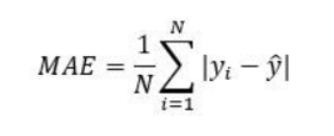
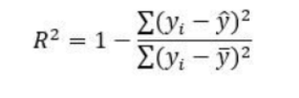
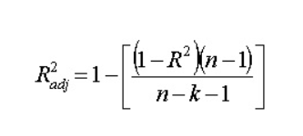
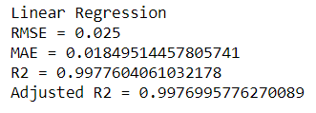
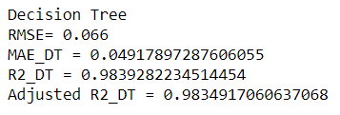
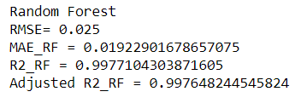
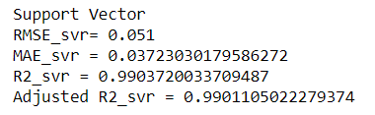
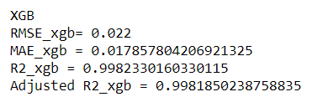
Metrics
Root Mean Square Error (RMSE) is the standard deviation of the residuals (prediction errors) and measure how spread out these residuals are.
Mean absolute error represents the average of the absolute difference between the actual and predicted values in the dataset.
R-squared represents the proportion of the variance in the dependent variable which is explained by the linear regression model. Less than 1.
Adjusted R squared is adjusted for the number of independent variables k in the model, and it will always be less than or equal to R².
SOME RESULTS –Comfort Delgro

Slide 14
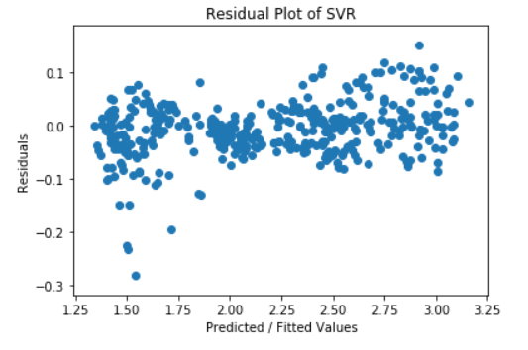
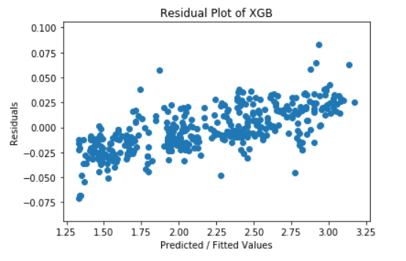
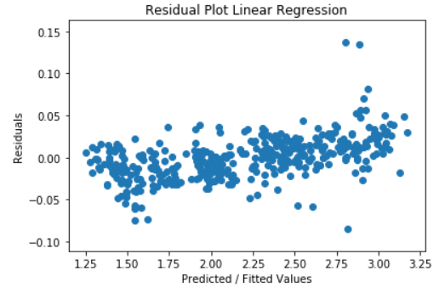
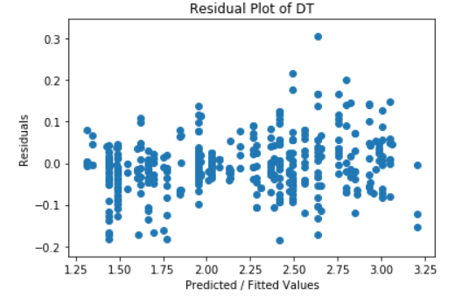
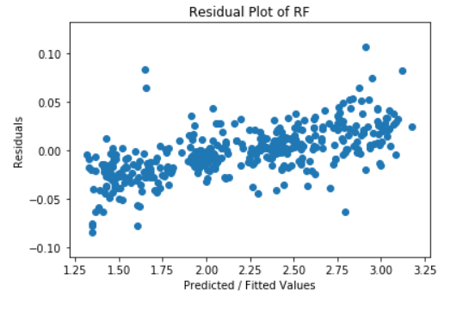
RESIDUAL PLOTS
A residual plot is typically used to find problems with regression.
Heteroscedastic data - points at widely varying distances from the line and typically a cone like shape.
Data that is non-linearly associated.
Data sets with outliers.
These problems are more easily seen with a residual plot than by looking at a plot of the original data set. Ideally, residual values should be equally and randomly spaced around the horizontal axis.
Data seems well scattered around zero, though looks like the residuals are larger compared to Linear Regression and Random Forest
Data randomly scattered around zero.
Since the residuals appear to be randomly scattered around zero, this is an indication that heteroscedasticity is not a problem with the predictor variable.
The Random Forest model has a better residuals plot clustered near zero and a better fit (smaller error term, higher R2) than compared to the Decision Tree Regressor

Slide 15

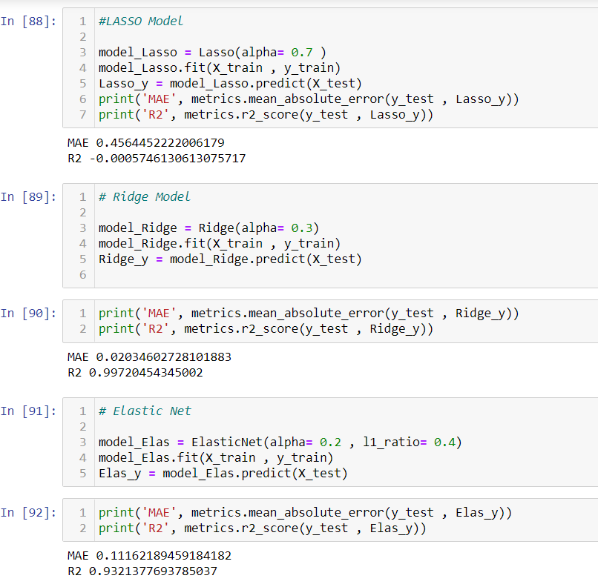
Regularisation
From Lasso, Ridge, ElasticNet, we have found the performance on test set to be the best in Ridge regression. The MAE has also shrunk from the original value of 0.035 under the normal linear regression.

Slide 16
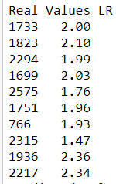
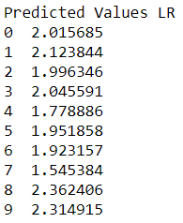
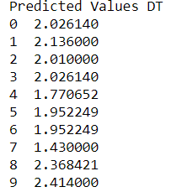
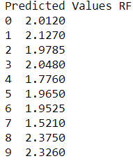
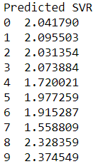
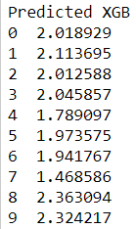
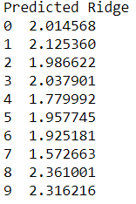
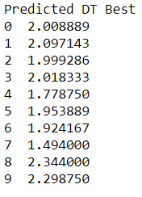
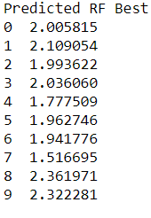
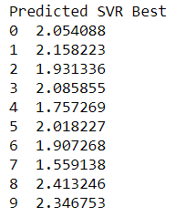
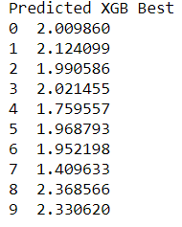
Predicted VS TRUE VALUES
Predicted values came in close to true values for most of the models.
Predicted Values using Hyperparameter Tuning (below) – compare to initial model prediction above
Looking at the first value of 2.00, hyperparameter tuning helped to improve the predictions except for SVR

Slide 17
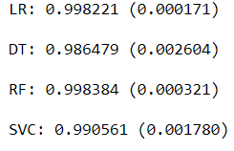
Validation of DATA
The goal of cross-validation is to test the model's ability to predict new data, in order to flag problems like overfitting or selection bias and to give an insight on how the model will generalize to an independent dataset
In K-Folds Cross Validation we split our data into k different subsets (or folds). We use k-1 subsets to train our data and leave thefold as validation. We then average the performance each of the folds. Our score is based on R-squared.

Slide 18
Hyperparameter tuning
Model parameters: estimated by the model from the given data.
Model hyperparameters: parameters that cannot be estimated by the model from the given data. These parameters are used to estimate the model parameters.
There are a few methods to consider. We will use Grid Search in our analysis as it is the most basic hyperparameter tuning meod.
Grid search - we build a model for each possible combination of all of the hyperparameter values provided, evaluating each model, and selecting the architecture which produces the best results.

Slide 19

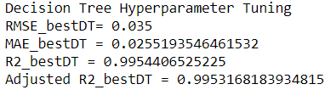
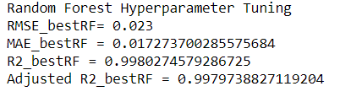
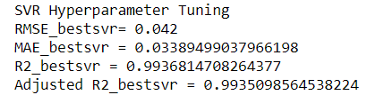
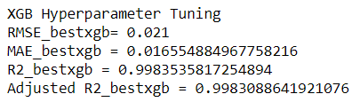
HYPERPARAMETER TUNING RESULTS
Not all tuning resulted in better error score and R2
Improvements were noted for Decision Tree, Random Foresr and Support Vector algorithms
Improvement in XGB boost was very slight
Regularisation techniques applied to the linear regression model did not see much improvement.

Slide 20
CONCLUSION
The regression machine learning models applied here yielded decent R2 results, error score and predicted values. The models which stood out seems to be Random Forest and XG Boost.
Cross validation and hyperparameter tuning saw slight improvements though the time taken could be significant
We need to handle correlated features with care as multicollinearity and overfitting were key concerns
The data also had limitations – did not adjust for any company news, financial results and stock splits, rights issues, which could have happened for some stocks over the last 10 years
Going forward, we can further explore:
Classification Models and Trading Signals
Live data
Trading system

Slide 21

https://github.com/Ste11a-star/stockanalysis

